Slide 1

The QUIC Transport Protocol
- Design and Internet-Scale Deployment
Chen, Zixuan

Slide 2

这里填写大标题

Slide 3

OUTLINE
0

Slide 4
Outline
1
INTRODUCTION
2
WHY QUIC
一段描述的语言，不要太长，但是超过一行会比较美观。
一段描述的语言，不要太长，但是超过一行会比较美观。
3
DESIGN & IMPLEMENTATION
4
EXPERIMENT & EXPERIENCE
一段描述的语言，不要太长，但是超过一行会比较美观。
一段描述的语言，不要太长，但是超过一行会比较美观。

Slide 5
INTRODUCTION
1

Slide 6
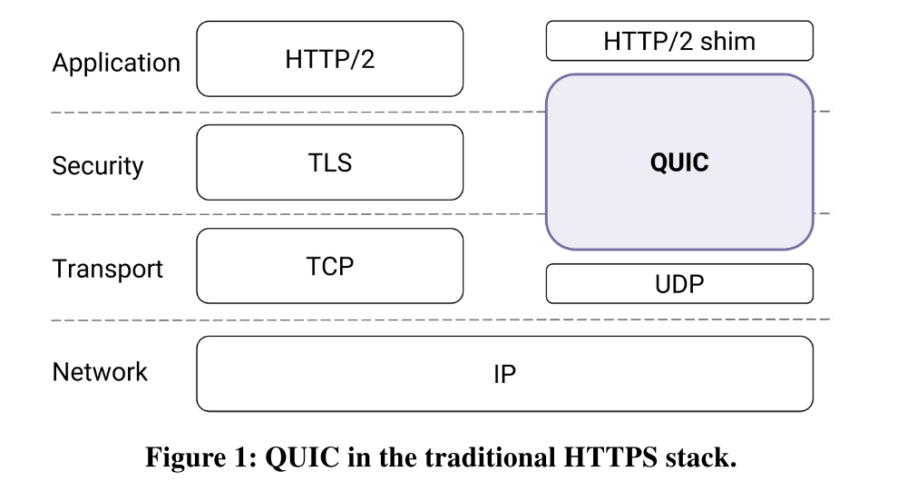
WHAT’s QUIC
QUIC (Quick Udp Internet Connection)
A new transport designed from the ground up to improve performance for HTTPS traffic and to enable rapid deployment and continued evolution of transport mechanisms.
QUIC replaces most of the traditional HTTPS stack: HTTP/2, TLS, and TCP (Figure 1).
QUIC is developed as a user-space transport with UDP as a substrate.

Slide 7
The Road to Deployment
QUIC has been globally deployed at Google on thousands of servers and is used to serve traffic to a range of clients including a widely-used web browser (Chrome) and a popular mobile video streaming app (YouTube).
On the server-side, our experience comes from deploying QUIC at Google’s front-end servers, which collectively handle billions of requests a day from web browsers and mobile apps across a wide range of services.
On the client side, we have deployed QUIC in Chrome, in our mobile video streaming YouTube app, and in the Google Search app on Android. We find that on average, QUIC reduces latency of Google Search responses by 8.0% for desktop users and by 3.6% for mobile users, and reduces rebuffer rates of YouTube playbacks by 18.0% for desktop users and 15.3% for mobile users.

Slide 8
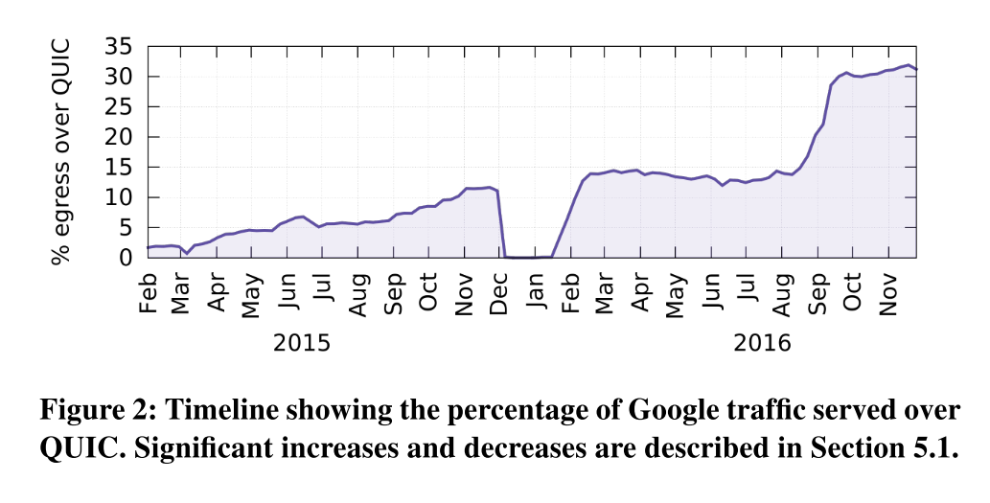
The Road to Deployment
As shown in Figure 2, QUIC is widely deployed: it currently accounts for over 30% of Google’s total egress traffic in bytes and consequently an estimated 7% of global Internet traffic [61].

Slide 9
WHY QUIC
2

Slide 10
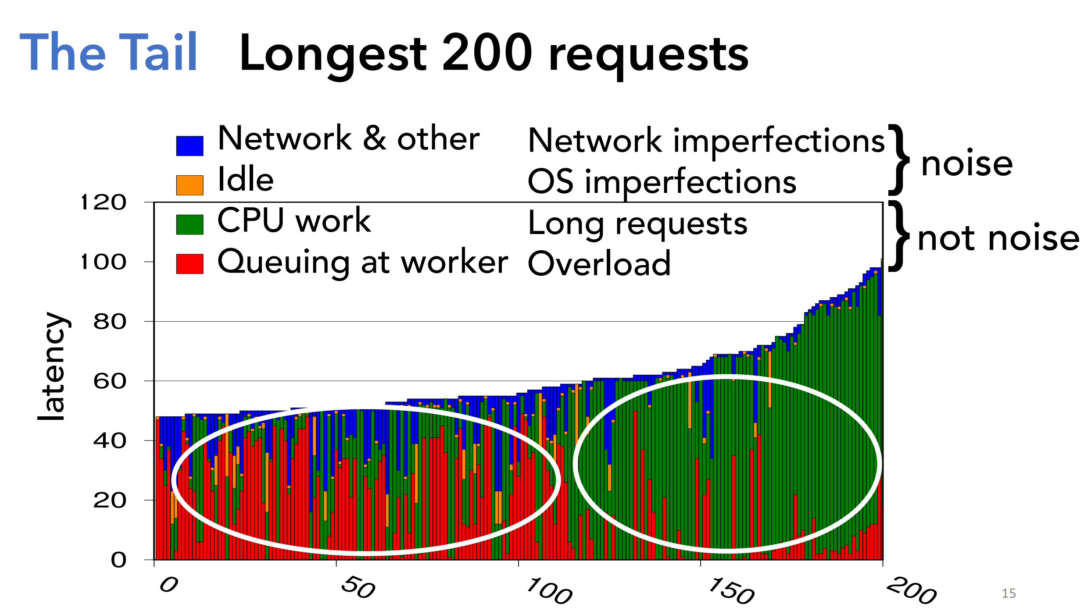
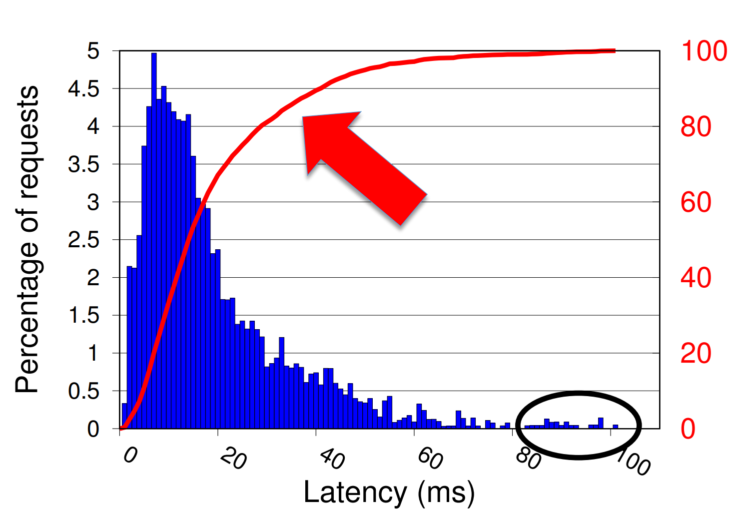
MOTIVATION: WHY QUIC
Growth in latency-sensitive web services and use of the web as a platform for applications is placing unprecedented demands on reducing web latency.
Web latency remains an impediment to improving user experience, and tail latency remains a hurdle to scaling the web platform.
Tail Latency
Measuring and Optimizing Tail Latency, Kathryn S McKinley, Google
https://cra.org/cra-wp/wp-content/uploads/sites/8/2018/04/VUTH-14-combined-slides.compressed.pdf

Slide 11
MOTIVATION: WHY QUIC
Shortcomings of TCP
Protocol Entrenchment
Implementation Entrenchment
Handshake Delay
Head-of-line Blocking Delay

Slide 12
Protocol Entrenchment
Middleboxes have accidentally become key control points in the Internet’s architecture.
Firewalls tend to block anything unfamiliar for security reasons and Network Address Translators (NATs) rewrite the transport header, making both incapable of allowing traffic from new transports without adding explicit support for them.
Any packet content not protected by end-to-end security.
Modifying TCP remains challenging due to its ossification by middleboxes.
Deploying changes to TCP has reached a point of diminishing returns, where simple protocol changes are now expected to take upwards of a decade to see significant deployment.

Slide 13
Implementation Entrenchment
TCP is commonly implemented in the Operating System (OS) kernel. As a result, even if TCP modifications were deployable, pushing changes to TCP stacks typically requires OS upgrades. This coupling of the transport implementation to the OS limits deployment velocity of TCP changes; OS upgrades have system-wide impact and the upgrade pipelines and mechanisms are appropriately cautious [28].
OS upgrades at servers tend to be faster by an order of magnitude but can still take many months because of appropriately rigorous stability and performance testing of the entire OS.
This limits the deployment and iteration velocity of even simple networking changes.

Slide 14
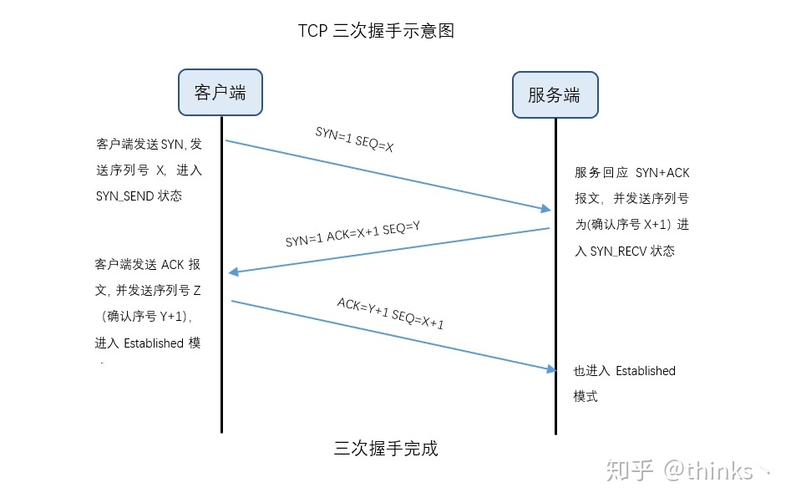
Handshake Delay
TCP connections commonly incur at least one round-trip delay of connection setup time before any application data can be sent, and TLS adds two round trips to this delay.
《TCP三次握手，四次挥手》
https://zhuanlan.zhihu.com/p/76874892

Slide 15
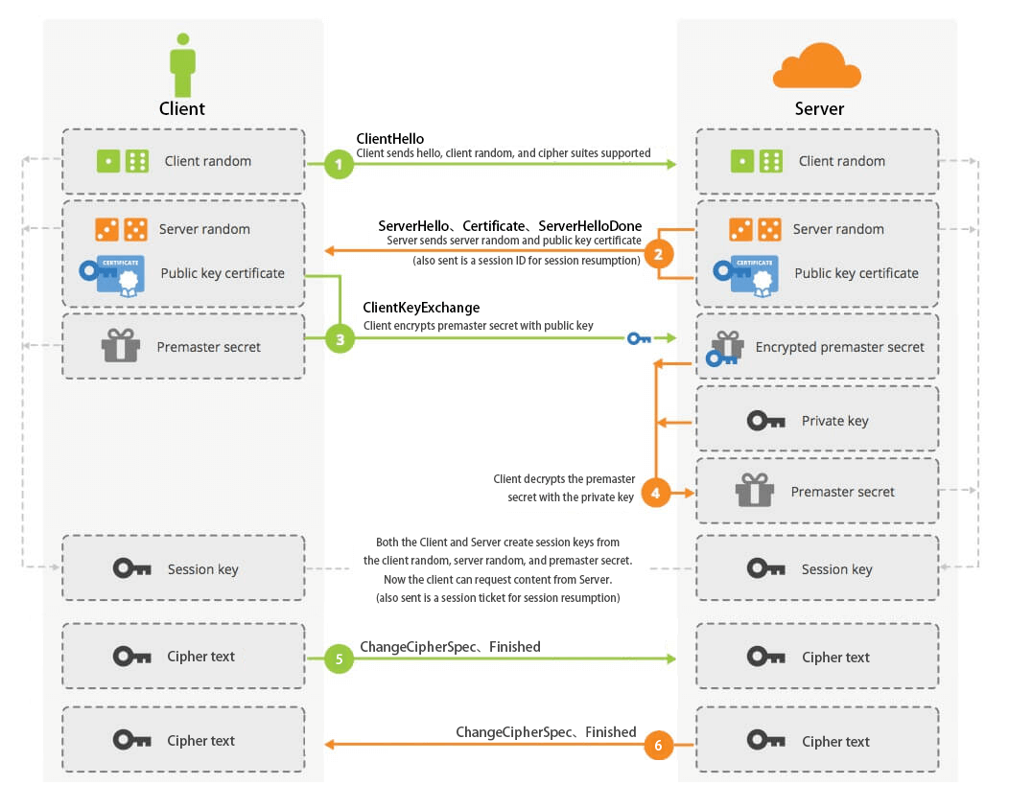
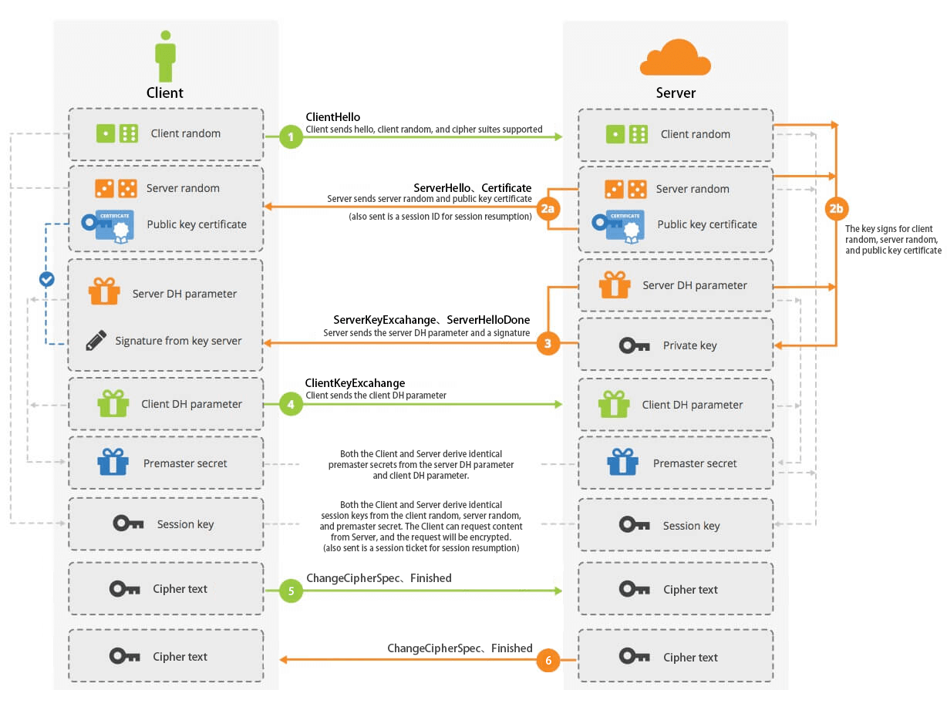
Handshake Delay
TLS Handshake RSA
TLS Handshake Diffie-Hellman
HTTPS 温故知新（三） —— 直观感受 TLS 握手流程(上)
https://halfrost.com/https_tls1-2_handshake/

Slide 16
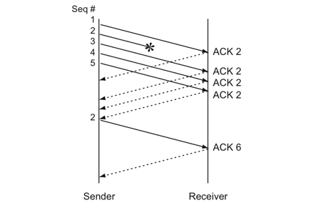
Head-of-line Blocking Delay
TCP’s bytestream abstraction, however, prevents applications from controlling the framing of their communications [12] and imposes a "latency tax" on application frames whose delivery must wait for retransmissions of previously lost TCP segments.
Sample of Fast Retransmit
浅谈TCP（1）：状态机与重传机制
https://monkeysayhi.github.io/2018/03/07/浅谈TCP（1）：状态机与重传机制/
Notes:
HTTP/2 多路复用，重传等待带来的影响将会更严重

Slide 17
QUIC’s Goal
QUIC is designed to meet several goals [59], including deployability, security, and reduction in handshake and head-of-line blocking delays.
The QUIC protocol combines its cryptographic and transport handshakes to minimize setup RTTs. It multiplexes multiple requests/responses over a single connection by providing each with its own stream, so that no response can be blocked by another.

Slide 18
DESIGN & IMPLEMENTATION
3

Slide 19
DESIGN & IMPLEMENTATION
Connection Establishment
Stream Multiplexing
Authentication and Encryption
Loss Recovery
Flow Control
Congestion Control
NAT Rebinding and Connection Migration
QUIC Discovery for HTTPS
Open-Source Implementation

Slide 20
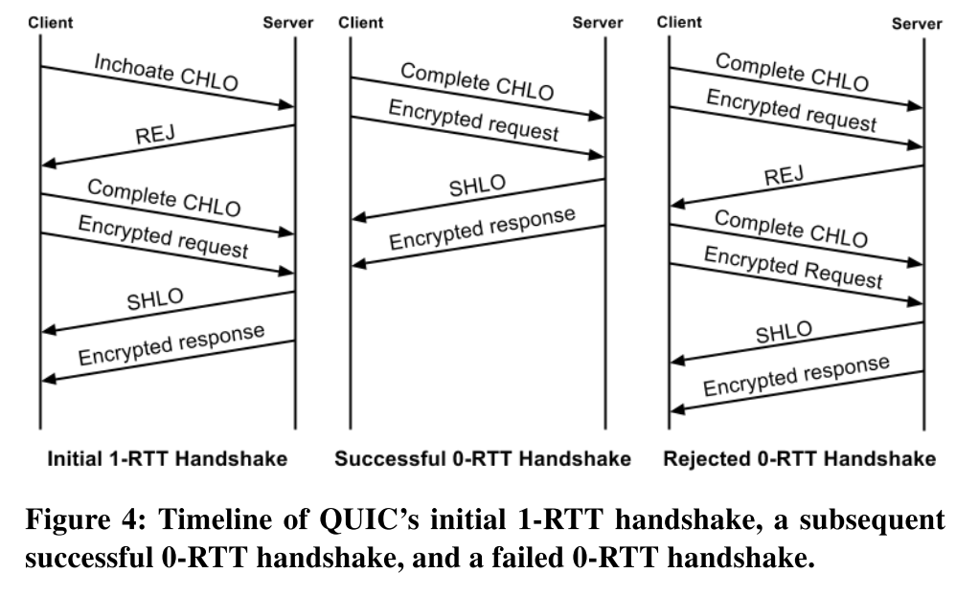
Connection Establishment
Annotations
Inchoate client hello (CHLO)
Reject (REJ)
Server hello (SHLO)
An origin is identified by the set of URI scheme, hostname, and port number.
Notes:
Origin 用于区分用户身份

Slide 21
Connection Establishment
REJ Message from Server
Server’s long-term Diffie-Hellman public value
A certificate chain authenticating the server
A signature of the server config using the private key from the leaf certificate of the chain
A source-address token: an authenticated-encryption block that contains the client’s publicly visible IP address (as seen at the server) and a timestamp by the server. The client sends this token back to the server in later handshakes, demonstrating ownership of its IP address.

Slide 22
Connection Establishment
Annotations
Inchoate client hello (CHLO)
Reject (REJ)
Server hello (SHLO)
An origin is identified by the set of URI scheme, hostname, and port number.
Notes:
Origin 用于区分用户身份

Slide 23
Connection Establishment
Version Negotiation
A QUIC client proposes a version to use for the connection in the first packet of the connection and encodes the rest of the handshake using the proposed version. If the server does not speak the client-chosen version, it forces version negotiation by sending back a Version Negotiation packet to the client carrying all of the server’s supported versions, causing a round trip of delay before connection establishment.
This mechanism eliminates round-trip latency when the client’s optimistically-chosen version is spoken by the server, and incentivizes servers to not lag behind clients in deployment of newer versions.
To prevent downgrade attacks, the initial version requested by the client and the list of versions supported by the server are both fed into the key-derivation function at both the client and the server while generating the final keys.

Slide 24
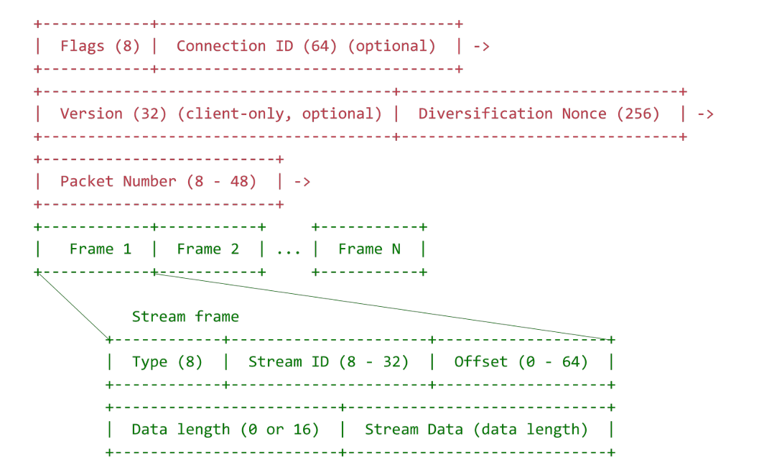
Stream Multiplexing
Applications commonly multiplex units of data within TCP’s single bytestream abstraction.
To avoid head-of-line blocking due to TCP’s sequential delivery, QUIC supports multiple streams within a connection, ensuring that a lost UDP packet only impacts those streams whose data was carried in that packet.
Padding Oracle Attack
Notes:
以包packet为传输单位，UDP packet
一个可选的16位无符号数字指定这个流帧中数据的长度。只有当包是 “全大小(full-sized)” 包时，才应该省略长度，来避免填充破坏的风险。

Slide 25
Stream Multiplexing
Packet Types and Formats
QUIC has Special Packets and Regular Packets. There are two types of Special Packets: Version Negotiation Packets and Public Reset Packets, and regular packets containing frames.
All QUIC packets should be sized to fit within the path’s MTU to avoid IP fragmentation. The current QUIC implementation uses a 1350-byte maximum QUIC packet size for IPv6, 1370 for IPv4. Both sizes are without IP and UDP overhead.
Frame Types and Formats
QUIC Frame Packets are populated by frames, which have a Frame Type byte, which itself has a type-dependent interpretation, followed by type-dependent frame header fields. All frames are contained within single QUIC Packets and no frame can span across a QUIC Packet boundary.

Slide 26
Stream Multiplexing
Packet 1
Success
Stream A Offset 1
Stream B Offset 1
Packet 2
Fail
Stream B Offset 2
Stream C Offset 3
Packet 3
Success
Stream A Offset 2
Time

Slide 27
Stream Multiplexing
Packet 2
Fail
Stream B Offset 2
Stream C Offset 3
Packet 3
Success
Stream A Offset 2
Did not been blocked
Packet 4
Success
Stream A Offset 3
Stream B Offset 2
Retransmit
Retransmit
Stream C Offset 3
Time

Slide 28
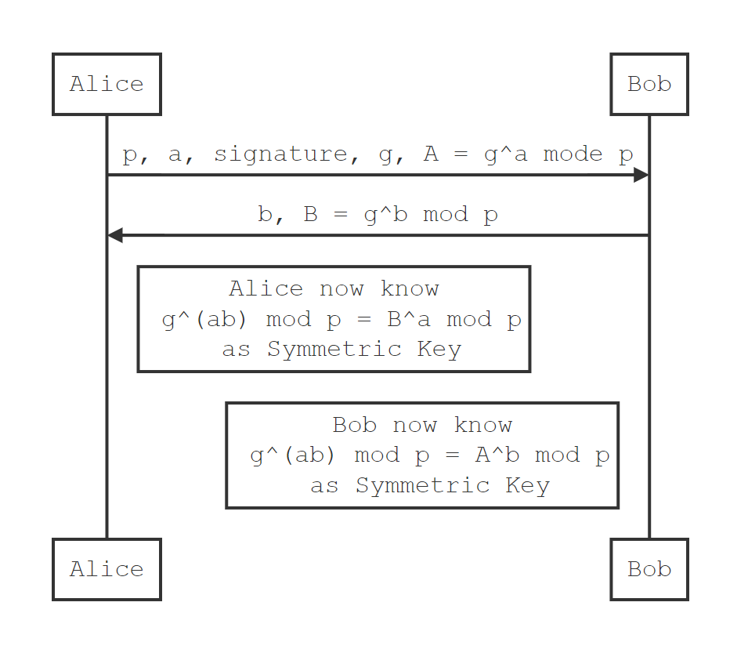
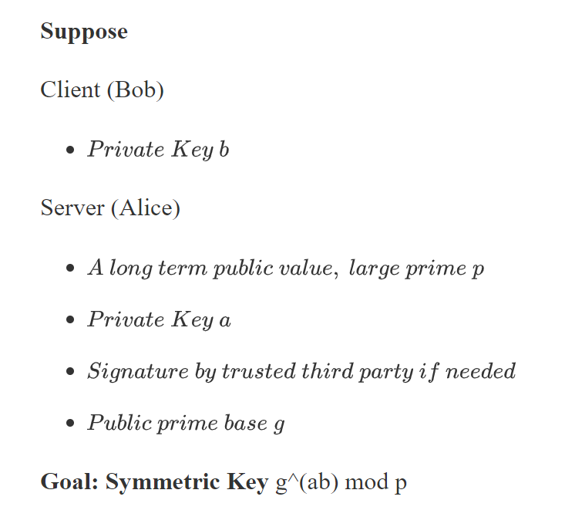
Authentication and Encryption
Cryptography - Diffie-Hellman
Notes:
第三方签名的必要性，中间人攻击

Slide 29
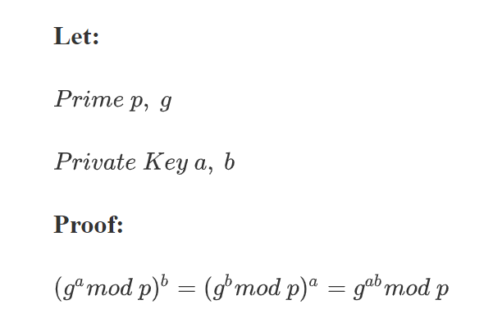
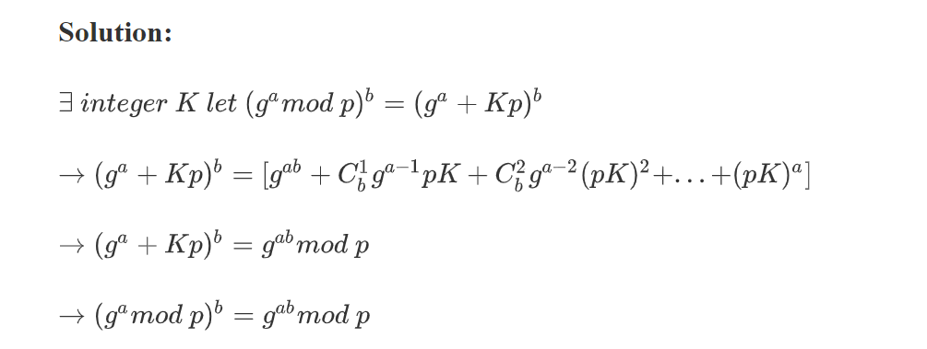
Authentication and Encryption
Proof of Diffie-Hellman

Slide 30
Authentication and Encryption

Slide 31
Loss Recovery
Proof of Diffie-Hellman

Slide 32
Flow Control
Proof of Diffie-Hellman

Slide 33
Congestion Control
Proof of Diffie-Hellman

Slide 34
NAT Rebinding and Connection Migration
Proof of Diffie-Hellman

Slide 35
QUIC Discovery for HTTPS
Proof of Diffie-Hellman

Slide 36
Open-Source Implementation
Proof of Diffie-Hellman

Slide 37
平行信息罗列
Input your information here. Make it longer than the title..
插入
相关
图片
项目名称
项目名称
项目名称
一段描述的语言，长一点，超过一行会比较好看。
一段描述的语言，长一点，超过一行会比较好看。
一段描述的语言，长一点，超过一行会比较好看。

Slide 38
排位信息罗列
Input your information here. Make it longer than the title..
1
简单的描述写在这里
3
简单的描述写在这里
一段描述的语言，不要太长，但是超过一行会比较美观。
一段描述的语言，不要太长，但是超过一行会比较美观。
2
简单的描述写在这里
4
简单的描述写在这里
一段描述的语言，不要太长，但是超过一行会比较美观。
一段描述的语言，不要太长，但是超过一行会比较美观。

Slide 39
案例理论结合
Input your information here. Make it longer than the title..
在左边插入一个合适的ICON，然后在这里写一段详细的描述，展示出这个案例的内容和基本结构。甚至你还可以在右边插入一张案例相关的图片。
在左边插入一个合适的ICON，然后在这里写一段详细的描述，展示出这个案例的内容和基本结构。甚至你还可以在右边插入一张案例相关的图片。
理论对接
这里可以写清楚案例可以表达的理论，名称、概念、基本要素等等信息都可以写在这里。

Slide 40
总结类型罗列
Input your information here. Make it longer than the title..
在这里输入小标题
在这里输入小标题
在这里输入小标题
在这里输入小标题
在上面请插入和主题相关的ICON，用Google搜索关键词+ICON，运用高级搜索的图片筛选功能就可以找到没有北京的PNG图片了。
下面可以简单介绍这个标题下面的内容，用来引领或者回顾都是不错的选择。
在上面请插入和主题相关的ICON，用Google搜索关键词+ICON，运用高级搜索的图片筛选功能就可以找到没有北京的PNG图片了。
下面可以简单介绍这个标题下面的内容，用来引领或者回顾都是不错的选择。
在上面请插入和主题相关的ICON，用Google搜索关键词+ICON，运用高级搜索的图片筛选功能就可以找到没有北京的PNG图片了。
下面可以简单介绍这个标题下面的内容，用来引领或者回顾都是不错的选择。
在上面请插入和主题相关的ICON，用Google搜索关键词+ICON，运用高级搜索的图片筛选功能就可以找到没有北京的PNG图片了。
下面可以简单介绍这个标题下面的内容，用来引领或者回顾都是不错的选择。

Slide 41

这里填写小标题
2

Slide 42
相关信息罗列
Input your information here. Make it longer than the title..
把白色的ICON换成主题相关的即可，Google图片能帮助你很快地找到它们。

Slide 43
表里信息排列
Input your information here. Make it longer than the title..
描述本层主题
可以在这里进行精要的解说，表现出来层次关系。
描述本层主题
描述本层主题
描述本层主题
描述本层主题
描述本层主题

Slide 44
增长型柱状图
Input your information here. Make it longer than the title..
+ 76%
在这里输入图表主题
+ 54%
你可以改动数字，拉长压短箭头，或者复制粘贴产生新的箭头来表现更多的数据。
+ 28%
2012
2013
2014

Slide 45
性别区分型调查分异
Input your information here. Make it longer than the title..
在这里插入男性对于话题的基本描述
80%
你可以拖拽条形的长度，修改数字的大小来使之符合主题的需要。
在这里插入男性对于话题的基本描述
70%
你可以拖拽条形的长度，修改数字的大小来使之符合主题的需要。

Slide 46

这里输入小标题
3

Slide 47
百分比型数据对比展示
Whoever evaluates your text cannot evaluate the way you write.
75%
50%
25%
输入小主题
输入小主题
输入小主题
点击图表，选择「设计」选项卡中的「编辑数据」按钮即可修改数据。.
点击图表，选择「设计」选项卡中的「编辑数据」按钮即可修改数据。.
点击图表，选择「设计」选项卡中的「编辑数据」按钮即可修改数据。.

Slide 48
同一事物内部百分比展示
Whoever evaluates your text cannot evaluate the way you write.
在这里输入简短的主题描述
选中右边的饼状图，按照上一页的方法即可修改其中的数据使之更符合主题的需要。
下方的图注也是可以手动修改的，调节颜色记得根据右边的图表颜色一致哟。
2014
2015
2016
2017

Slide 49
柱状图的纵向对比
Whoever evaluates your text cannot evaluate the way you write.
在这里输入小主题
同样地，右边是可以利用表格功能调整数据的柱状图。
简单的数据比对用这个模板可能会展示得更为清晰。

Slide 50
柱状图的横向对比
Whoever evaluates your text cannot evaluate the way you write.
1
输入主题
输入主题
1
100%
100%
2
输入主题
输入主题
2
80%
80%
3
输入主题
输入主题
3
60%
60%
4
输入主题
输入主题
4
40%
40%

Slide 51
THANKS

